Slide 1

1````````````````````````````````z
Predictive Analytics in Manufacturing
Sowmya Ravichandran

Slide 2

Project Background

Slide 3
What is Predictive Analytics ?
Predictive analytics assists manufacturers in predicting machine failures ,
or to predict the maintenance required for machines in advance.

Slide 4
Predictive Analytics Evolution
In the past, reactive maintenance was used, in which the problem was
handled after a machine break down.
Resulted in a significant loss due to the downtime.
Caused reduction in product quality, and the inability to deliver the product to the client on time.

Slide 5
Motivation
Prevent machine failures in advance.
Enhance quality in manufacturing process.
Reduce machine downtime

Slide 6
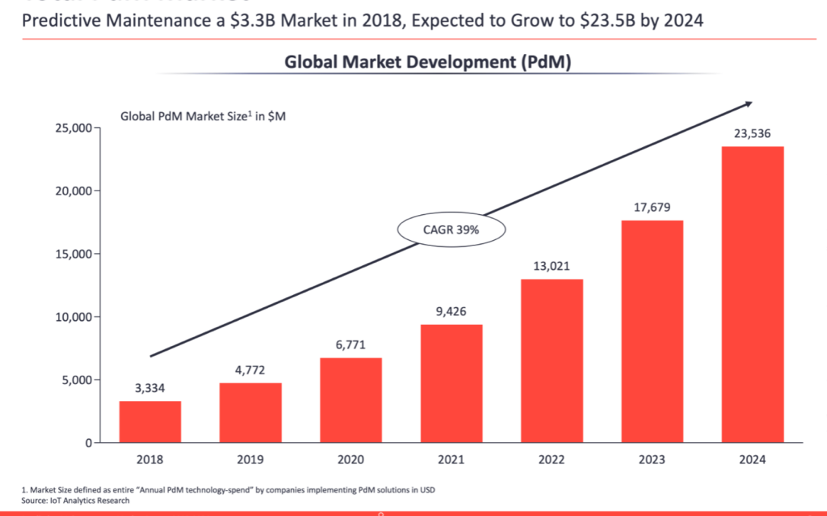
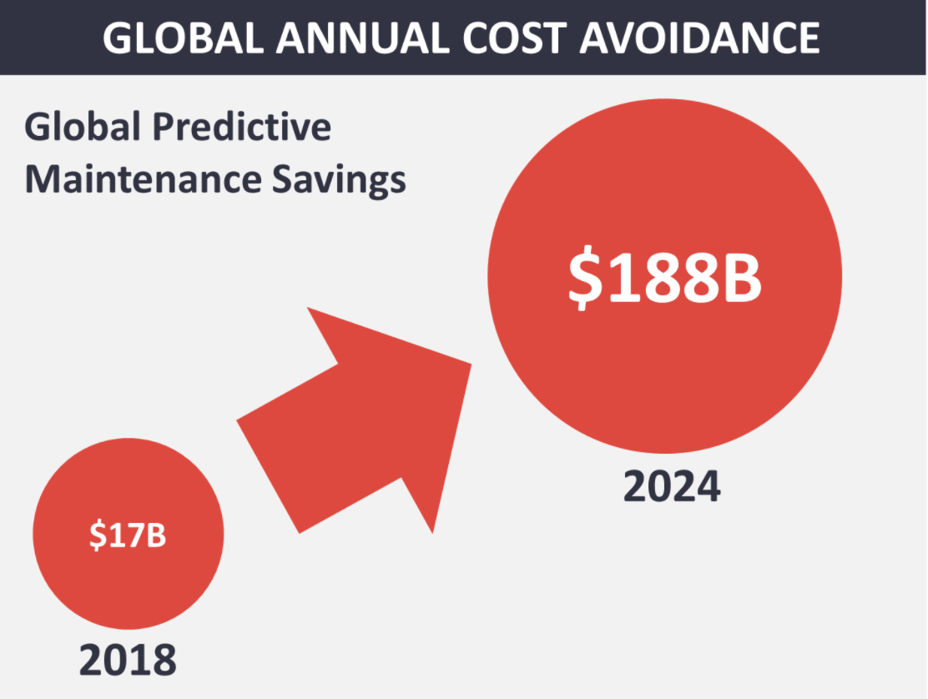
Needs
Predictive Maintenance Market Growth
Maintenance Cost Avoidance
https://iot-analytics.com/numbers-of-predictive-maintenance-vendors-surges/

Slide 7
Targeted problem
Water Pump failures prevention.
Address costs associated around failure of water pumps.
Deliverables
Model to prevent pump failure in advance.
Alerting system to report pump related anomalies.
Dashboard to monitor all sensors.
Hourly Pump status report.

Slide 8
Existing Methods
New Solution
Human intervention on checking
Pump discharge flow
Excessive noise
Overheating of pump
Air leaks
Suction pressure
Vibration
Sensors
Using IoT sensors to prevent human intervention.
ML Models to predict machine failures.
Dashboard to report machine status

Slide 9
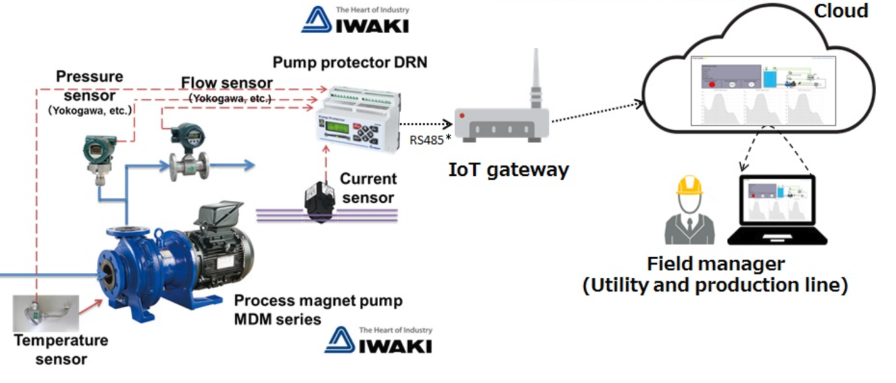
IOT Based Remote Water Pump Monitoring
https://www.environmentalengineering.org.uk/news/iiot-based-remote-pump-monitoring-6216/

Slide 10
Project Requirements & Task Organization

Slide 11
Project Requirements
Data Requirement
Device Requirement
Time Series data(every minute) from sensors.
Pre-processing and normalize data.
Ensure Data security.
IoT sensors to record data.
IoT gateway to aggregate data from IoT sensors.
AWS VM’s.

Slide 12
Project Requirements
Cloud Services
Web UI
Receive stream data from IoT gateway.
Data pre-processing.
Run ML models using AWS services.
Water pump performance live dashboard.
IoT Sensors status (live/dead/malfunctioning)
Alerting system if anomaly is detected.

Slide 13
Task Organization
Understand pump internals
Configure IoT gateway
Water pump field analysis
IoT sensor research/ Installation
Connect IoT gateway to cloud services
Receive stream data on Cloud
Pre-Process data
ML Model Analysis
Result Dashboard

Slide 14
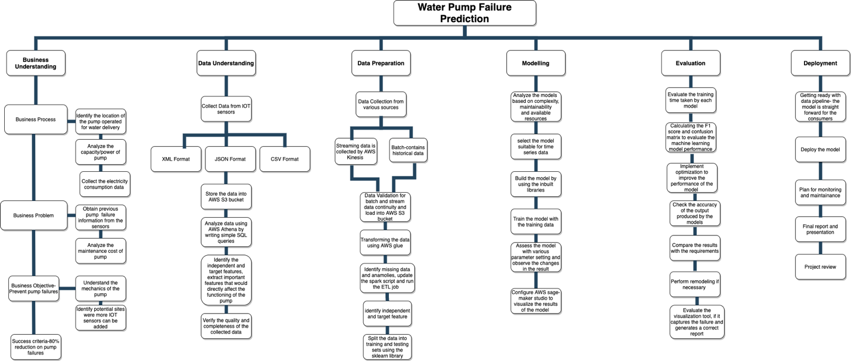
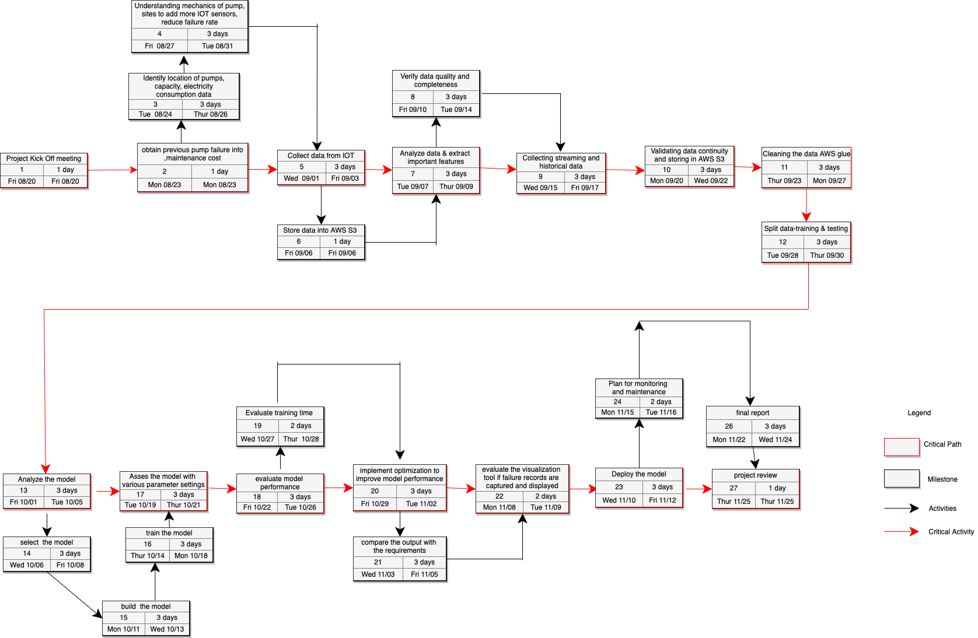
Work Breakdown Structure
PERT Chart

Slide 15
Technology and Literature Survey

Slide 16
Literature Survey
Goal | Dataset | Solution | Performance | Relevant finding
Detecting defects in water pump in steam turbine [1] | Time series data collected from sensors for one year. | Preprocessing techniques like standardization scale [0,1] and [-1,1] and normalization are used to align the data to a common scale. ARIMA and Regression Artificial Neural Network models are implemented. | The proposed algorithm ARIMA significantly outperforms an existing technique, Regression Artificial Neural Network. | IoT based machine learning is very efficient and cost effective. Mahalanobis distance finds the outliers by measuring the predicted value distance and warn for inspecting the equipment.
Predicting failure and monitoring the status of water pump [2] | The data is collected from Tanzania Ministry of Water. | Data mining approach was used to find the patterns of the data. Recursive Feature Elimination (RFE) to extract important features. | XGBoost, Random Forest, SVM models were used. XGBoost predicted the failure of the water pump with 80.38% accuracy. | Instead of human inspection, data mining techniques are particularly useful for swiftly gaining insights into data.
Wastewater Plant Reliability Prediction [3] | Data collected from the sensors capturing water level, capacity, current and flow and so on. | Imbalanced data is handled by using the under sampling and oversampling techniques. Artificial neural networks, Random Forest (RF) , Gradient Boosting Trees (GBT), K-Nearest Neighbors (KNN) are used. | A confusion matrix is utilized to see the prediction performance of the models. KNN gives the highest accuracy of 98.9% and 99.97% compared to other models. | Data should be balanced, and more data for analysis is required. Pre-processing and data collecting in a timely manner are critical for any manufacturing machinery.
Electric submersible pump diagnosis [4] | Data of different components of the pump is collected using sensors. | As an unsupervised machine learning model, Principal Component Analysis (PCA) is utilized. | PCA has the capacity to anticipate dynamic changes and promptly identify issues. | To forecast failures, PCA can be used as a unsupervised machine learning and can be used to pre-processing data.
Detecting water pipe leaks with smart sensors [5] | Data is collected from the sensors. | Gradient boosting technique is used. | 75% water leaks were correctly identified by the model. | Acoustic monitoring has proven to be the most effective method for detecting leaks.

Slide 17
Technical Solutions
Goal | Dataset | Solution | Performance | Relevant finding
A Comparative Study on various Machine Learning models[6] | Data from the CNC machine collected using sensors | Comparative study between Random Forest (RFs), Support Vector Machine (SVM), KNN. | Among the three, the measure of coefficient of R2 of RFs was 0.992. | The training time was more for RFs, but it outperformed the other two in terms of squared error and R2 values predicting with high accuracy.
Comparison of Deep learning models for smart manufacturing [7] | Time series data measuring the operational speed of aluminum can making machine | multistep time series forecasting (using previous observation as input predicting the output) was employed. | Deep belief networks, convolutional neural networks (CNN), recurrent neural networks (RNN) and LSTM deep learning models were implemented. LSTM proved to be the best model. | Multistep forecasting made it possible to anticipate machine speed in advance, indicating future production output and allowing operational requirements to be modified correspondingly.
Comparison between the boosting and bagging algorithms for monitoring small manufacturing plants[8] | Data is collected from a historical static database | The bagging and boosting techniques were implemented. | As the data collected is non-linear XGBoost showed high accuracy compared to RFs. | The boosting technique XGBoost algorithm performs well on non-linear data whereas the bagging technique Random forest works well on linear dataset

Slide 18
Summary of literature survey
IoT based machine monitoring is efficient and cost effective.
Normalization is important for accurate results.
Mahalanobis distance is effective to identify outliers.
Multistep time series forecasting (using previous observation as input & predicting the output) can be used for future production estimate.
Data mining approach to find the patterns of the data.

Slide 19
Project Required Resources, Technology and Platform

Slide 20
Resources Table Overview
Type of Resources | Requirements | Cost | Justification
Tool/Device | Sensors | $ 3.8 | The cost of one sensor is estimated to be 38 cents. Sensors are required to capture the suction pressure, discharge pressure, vibration, water flow, temperature , quality of water, and electric power reading of the water pump.
Tool/Device | IoT gateway | $ 148 | IoT gateways are used to collect data from the sensors, aggregate it, and transfer it to the cloud.
Cloud Platform | Amazon Web services | $ 600 | A large volume of data is generated by sensors, to effectively manage cloud platform is required, hence AWS is chosen for this project. Amazon services such as Kinesis ,S3, Glacier, Glue, SageMaker, Lambda functions are utilized.
Software | Python 3.7 | 0 | The machine learning algorithms and lambda functions are written using python 3.7.
Software | Scikit-learn and TensorFlow | 0 | Scikit-learn and TensorFlow are machine learning libraries featuring various algorithms. The machine learning models for this project is implemented by using these open-source libraries.
Hardware | Amazon EC2 ml.p3.2xlarge | $ 200 | The machine learning models require high computational machines to make accurate predictions on time.
UI | React framework | 0 | Dashboard to monitor pump and sensor status.

Slide 21
Project Data Preparation

Slide 22
Information of Raw Dataset
Time series data generated by IoT devices installed on water pump.
Data collected for every second over a period of five months.
Data consists of 220320 rows and 20 columns.
Each column measured in different units.
Missing value.
Redundancy.

Slide 23
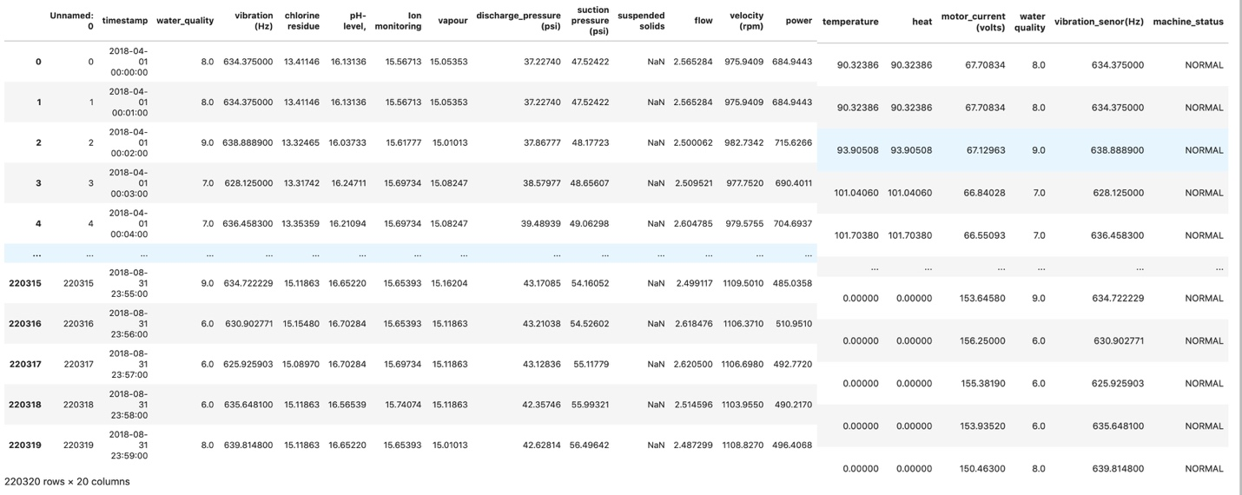
Sample Raw Dataset

Slide 24
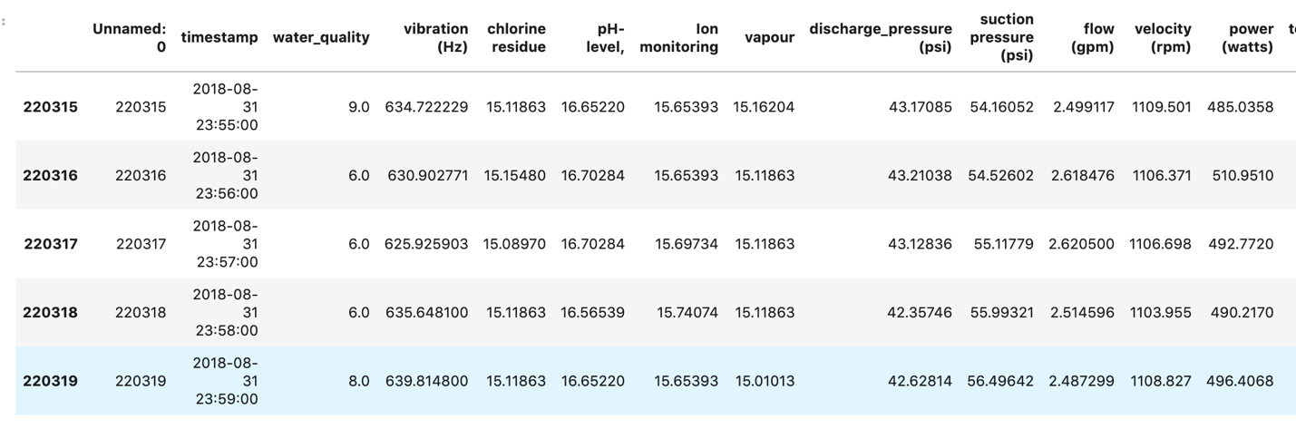
Sample Pre-Processed Dataset
Missing values were replaced using SimpleImputer and kNNImputer.
Sample columns with missing values are water quality, vibration, chlorine residue,
pH-level, Ion monitoring, vapor, suspended solids.

Slide 25
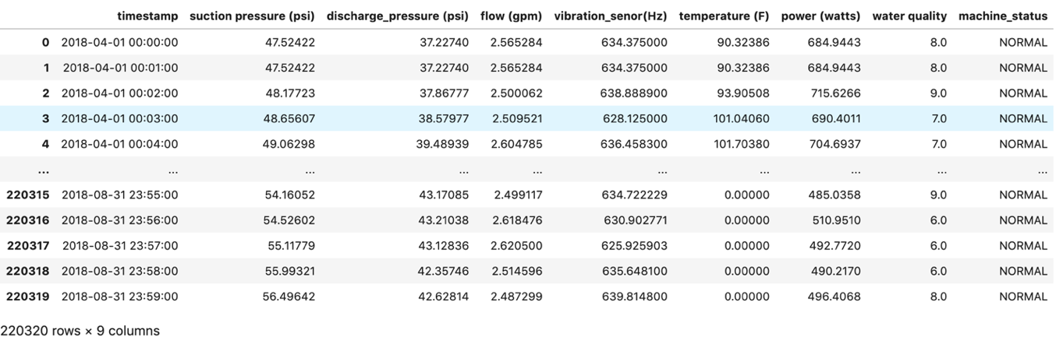
Sample Pre-Processed Dataset (Contd..)
Dataset After Performing Dimensionality Reduction

Slide 26
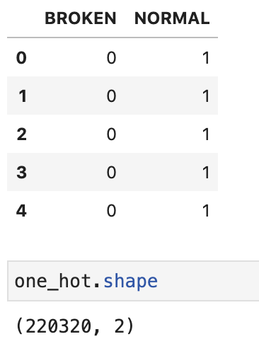
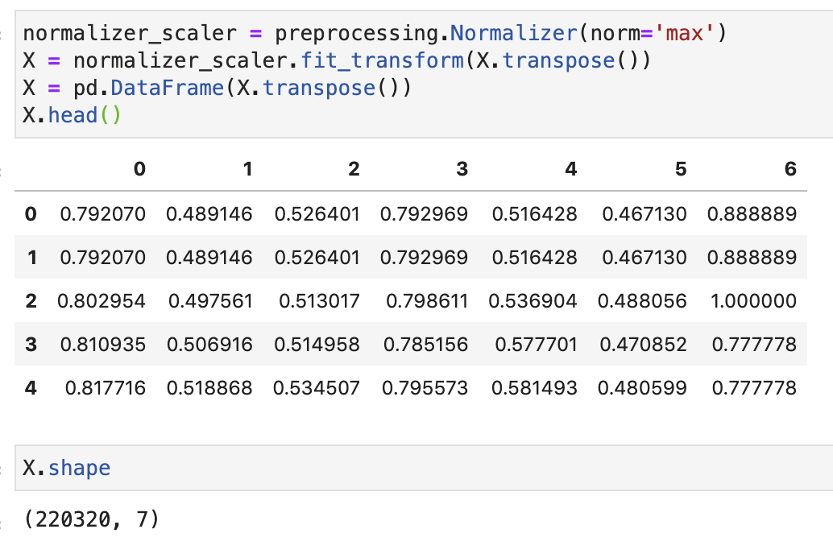
Samples of Pre-Processed Dataset (Contd..)
Target variable to binary values
Dataset After Performing normalization

Slide 27
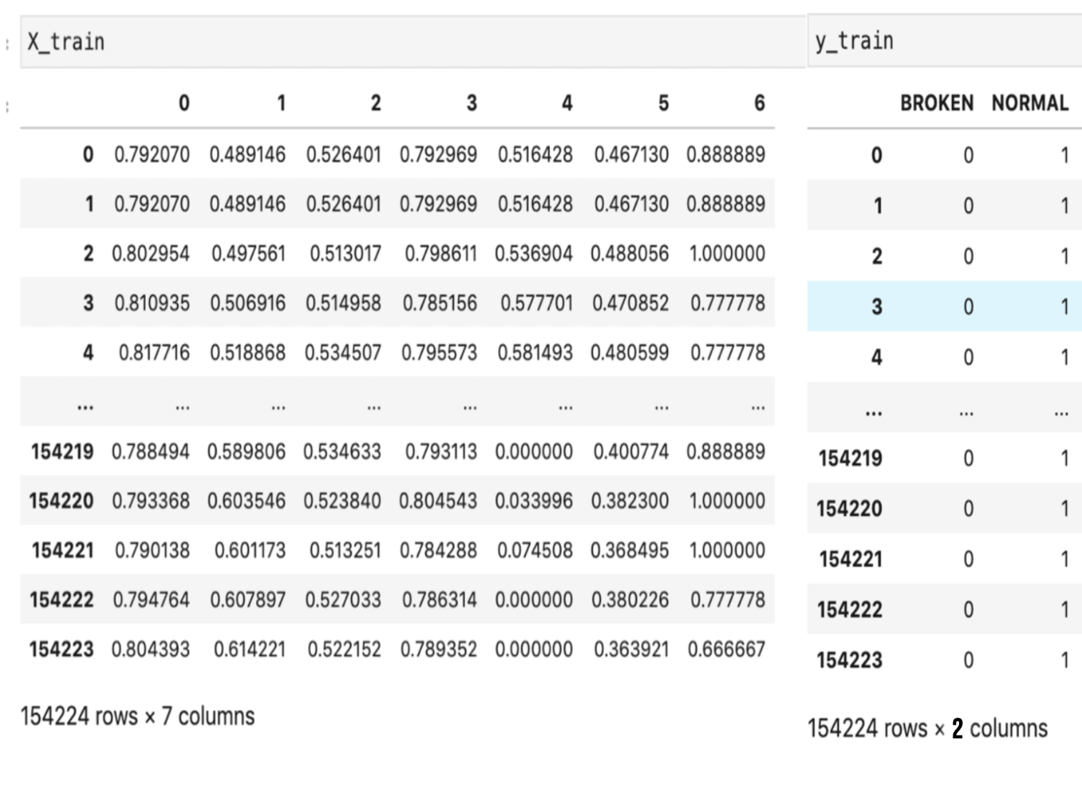
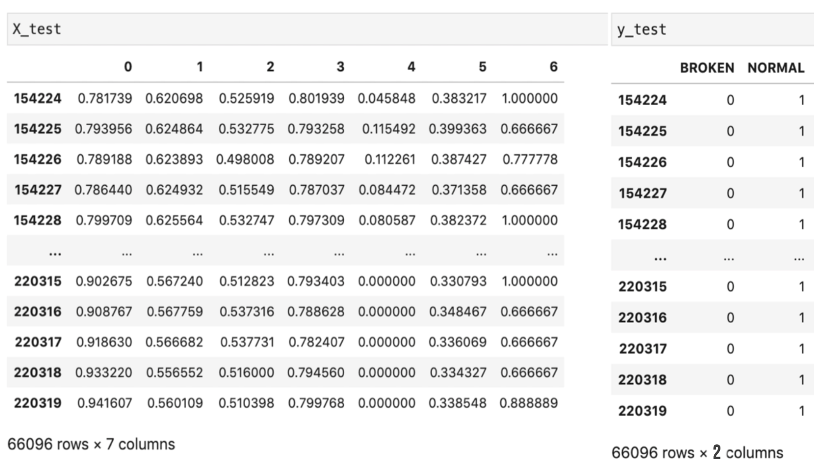
Samples of test Dataset
Training Dataset- 70%
Testing Dataset- 30%

Slide 28
Machine Learning Models

Slide 29
Models
Logistic Regression
ARIMA
LSTM
XGBoost

Slide 30
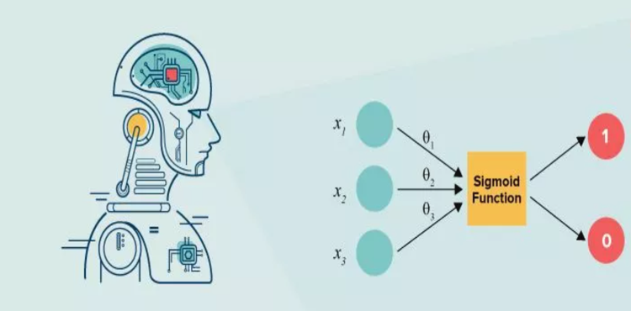
Logistic Regression Architecture
x1,x2,x3 – Data points.
θ1,θ2,θ3 – slope and intercept.
Presence of outliers modifies best fit line to either greater than 0 or less than 1.
Sigmoid function removes the effect of outliers in the model.
It is represented by an S shaped curve where the value lies between zero and one.
Value below the threshold classified as 1 , above the threshold as 0.
https://www.knowledgehut.com/blog/data-science/logistic-regression-for-machine-learning

Slide 31
Logistic Regression
Advantages
Disadvantages
Justification
Easy to train and implement.
Expanded to support multi-class classification.
Good accuracy when the data points are linearly separable.
Overfitting can be solved by the regularization technique.
More Training data is required, otherwise the model is prone to overfitting.
Perform well on test data, but not on actual data.
Data must be distributed linearly.
The decision boundary changes rapidly due to the presence of outliers.
Water pump monitoring data is linearly separable.
Simple to implement.
Output is a categorical that forecasts the likelihood of a given instance belonging to one of several classes.

Slide 32
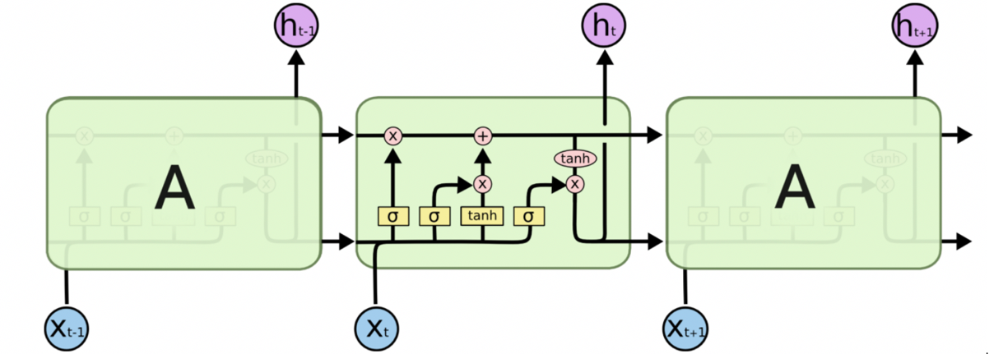
LSTM Architecture
Main components are memory cell, forget gate, input and output gate.
Rectangular boxes(neural network layer), circles(pointwise operator), arrows(vector to transfer information).
Memory cell - Top line with pointwise operator.
Forget gate - left sigmoid function with pointwise operator.
Input gate – middle sigmoid function with tanh.
Output gate - sigmoid function with tanh at the right.
http://colah.github.io/posts/2015-08-Understanding-LSTMs/

Slide 33
LSTM
Advantages
Disadvantages
Justification
Persists past and present information for long time.
For inputs with a sequence, the LSTM is a good model.
Learning rate, input and output biases are provided in the model.
Stores lot of information in the memory and hence takes lot of time for training.
The model must be implemented in a hardware which has a good memory.
LSTM is prone to overfitting most of the time.
Time series data is collected; hence this model is appropriate as the previous timestamp data is kept in memory for a long time, the model learns from the data in memory to predict the future value.

Slide 34
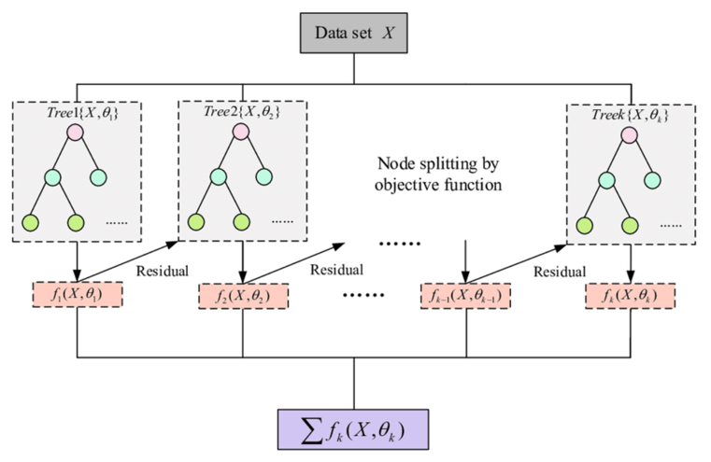
XGBoost Architecture
v
The residue is the difference between the target feature and the probability.
The decision tree is constructed by taking the value of the residue.
This is continued until the residue becomes very low.
https://www.researchgate.net/figure/Flow-chart-of-XGBoost_fig3_345327934

Slide 35
XGBoost
Advantages
Disadvantages
Justification
Handles the overfitting problem using the inbuilt regularization technique.
High computational power, uses parallel processing.
Handle missing values
Runs cross-validation in each iteration to get the best possible output
Split a tree to a maximum depth then prune the tree if there is a loss
Inability to perform well on unstructured data.
Requires a large training set
sensitive to outliers.
Pump failure must be investigated as soon as possible. Because of its execution speed and performance, XGBoost is used.

Slide 36
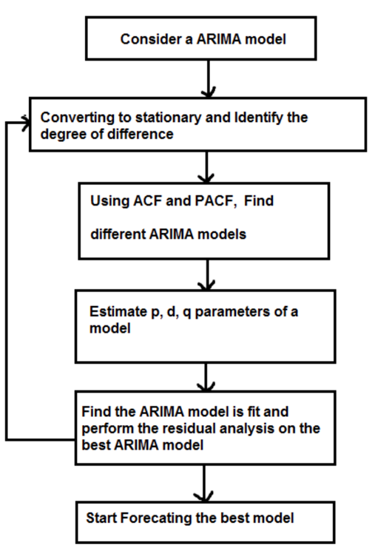
ARIMA Flowchart
The ARIMA model has 3 parameters p, d and q.
p - the number of previous observations given to the model.
d - difference between previous and current observation.
q - average window size.
The trend line should be stationary with constant mean.
https://www.researchgate.net/figure/Flow-Diagram-of-ARIMA-Model-ARIMA-is-also-known-as-
Box-Jenkins-approach-To-build-a-time_fig1_319061523

Slide 37
ARIMA
Advantages
Disadvantages
Justification
ARIMA is known for time series forecasting.
Only requires the previous time series data to predict the next outcome.
Good prediction accuracy.
Requires minimum parameters for prediction
Expertise needed to evaluate the model based on the input data.
Depends on the past values, hence prediction resembles the past giving inaccurate results.
Data must be stationary.
ARIMA models are more flexible than other statistical models
Forecasting in general is tough. ARIMA performs well compared to other forecasting algorithm

Slide 38
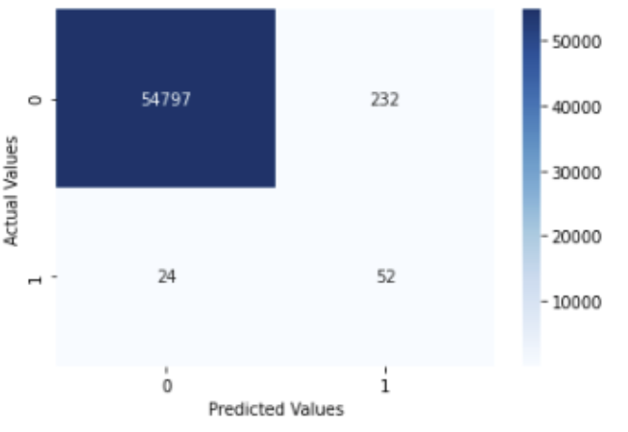
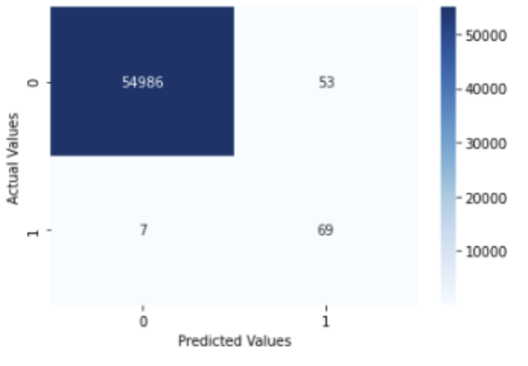
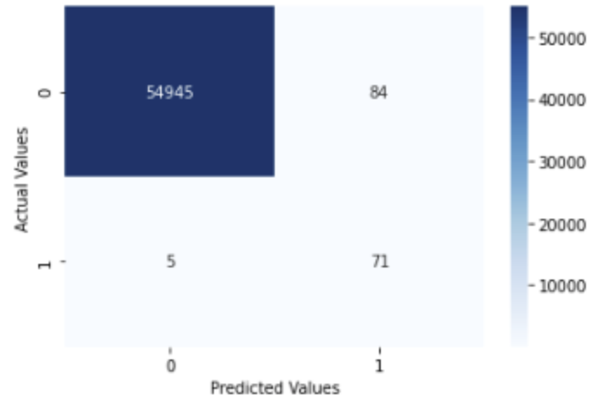
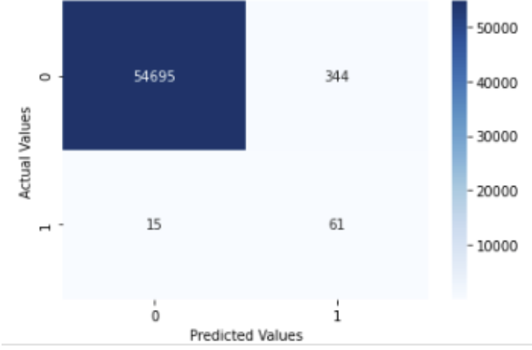
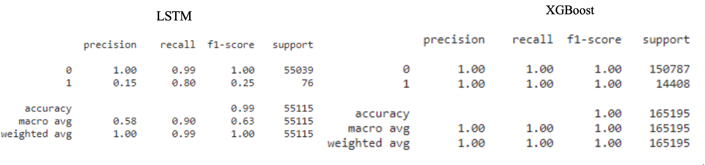
Model Comparison
Logistic Regression
XGBoost
LSTM
ARIMA
https://becominghuman.ai/predict-pump-failure-before-it-happens-using-deep-learning-model-dc886bfa073e

Slide 39
References
Sanayha, M., & Vateekul, P. (2017). Fault detection for circulating water pump using time series forecasting
and Outlier Detection. 2017 9th International Conference on Knowledge and Smart Technology (KST).
https://doi.org/10.1109/kst.2017.7886095
2. Darmatasia, & Arymurthy, A. M. (2016). Predicting the status of water pumps using data mining approach.
2016 International Workshop on Big Data and Information Security (IWBIS).
https://doi.org/10.1109/iwbis.2016.7872890
3. Velimirović, L. Z., Janković, R., Velimirović, J. D., & Janjić, A. (2021). Wastewater plant reliability prediction
using the Machine Learning Classification algorithms. Symmetry, 13(8), 1518.
https://doi.org/10.3390/sym13081518
4. Peng, L., Han, G., Landjobo Pagou, A., & Shu, J. (2020). Electric submersible pump broken shaft fault diagnosis
based on principal component analysis. Journal of Petroleum Science and Engineering, 191, 107154.
https://doi.org/10.1016/j.petrol.2020.107154
5. Liang, B., Verma, S., Xu, J., Liang, S., Li, Z., Wang, Y., & Chen, F. (2020). A data driven approach for
LEAK detection with smart sensors. 2020 16th International Conference on Control, Automation,
Robotics and Vision (ICARCV). https://doi.org/10.1109/icarcv50220.2020.9305403

Slide 40
References
6. Wu, D., Jennings, C., Terpenny, J., Gao, R. X., & Kumara, S. (2017). A comparative study on machine learning algorithms for Smart Manufacturing:
Tool wear prediction using random forests. Journal of Manufacturing Science and Engineering, 139(7). https://doi.org/10.1115/1.4036350
7. Essien, A., & Giannetti, C. (2020). A deep learning model for smart manufacturing using convolutional LSTM neural
network autoencoders. IEEE Transactions on Industrial Informatics, 16(9), 6069–6078. https://doi.org/10.1109/tii.2020.2967556
8. Kiangala, S. K., & Wang, Z. (2021). An effective adaptive customization framework for small manufacturing plants
using extreme gradient boosting-xgboost and random forest ensemble learning algorithms in an industry 4.0 environment.
Machine Learning with Applications, 4, 100024. https://doi.org/10.1016/j.mlwa.2021.100024

Slide 41
Thank You

